Slide 1
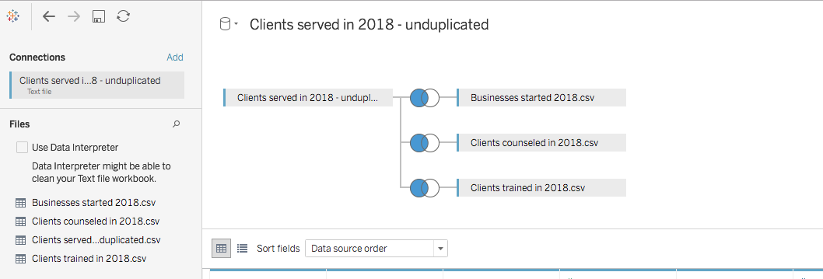
Dataset
Four datasets were imported into Tableau. Found “System Name ID” as the common denominator and created a left join.

Slide 2
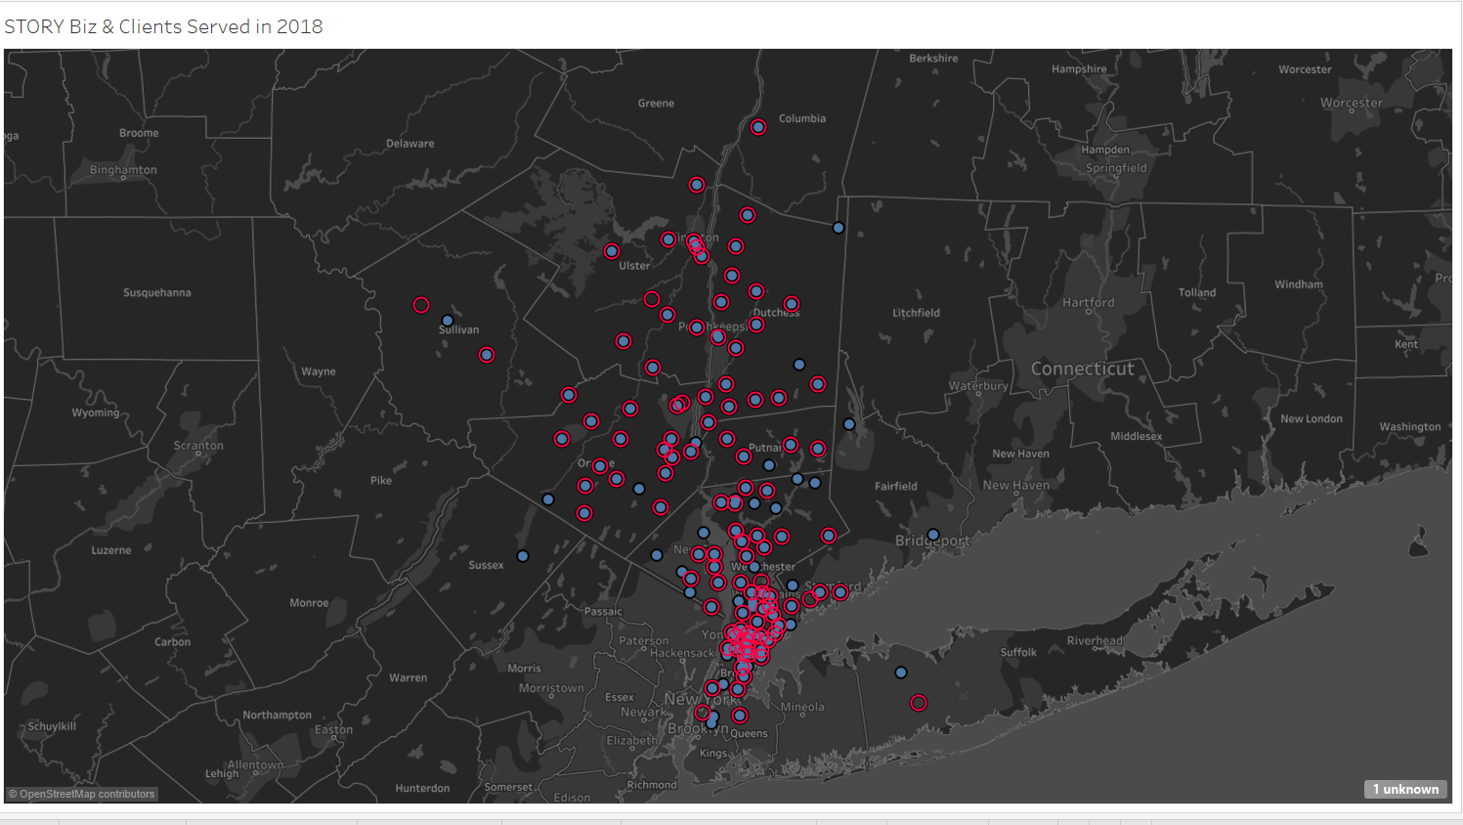
Screenshots of Data Visualizations

Slide 3
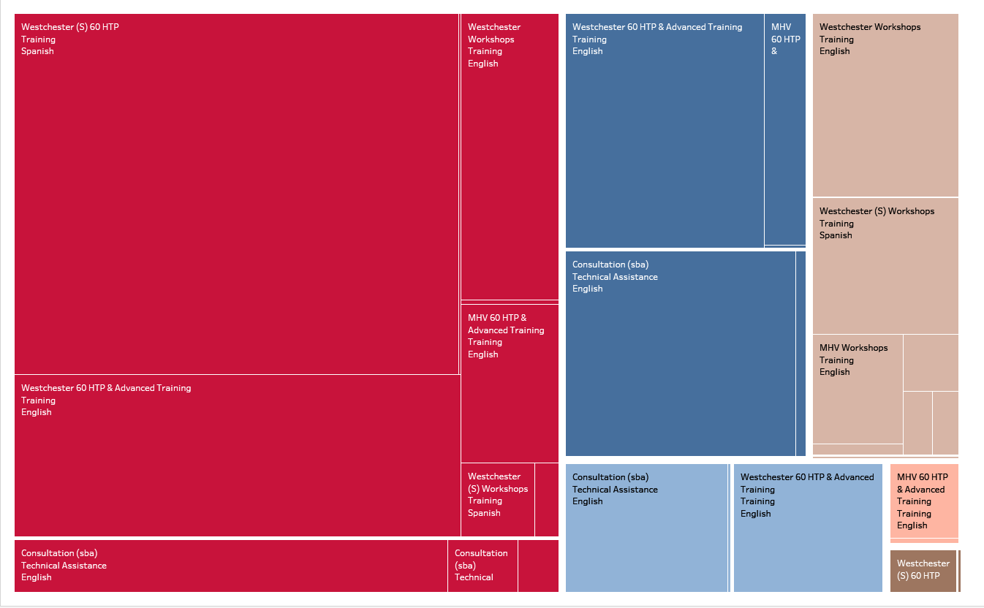
Screenshots of Data Visualizations

Slide 4
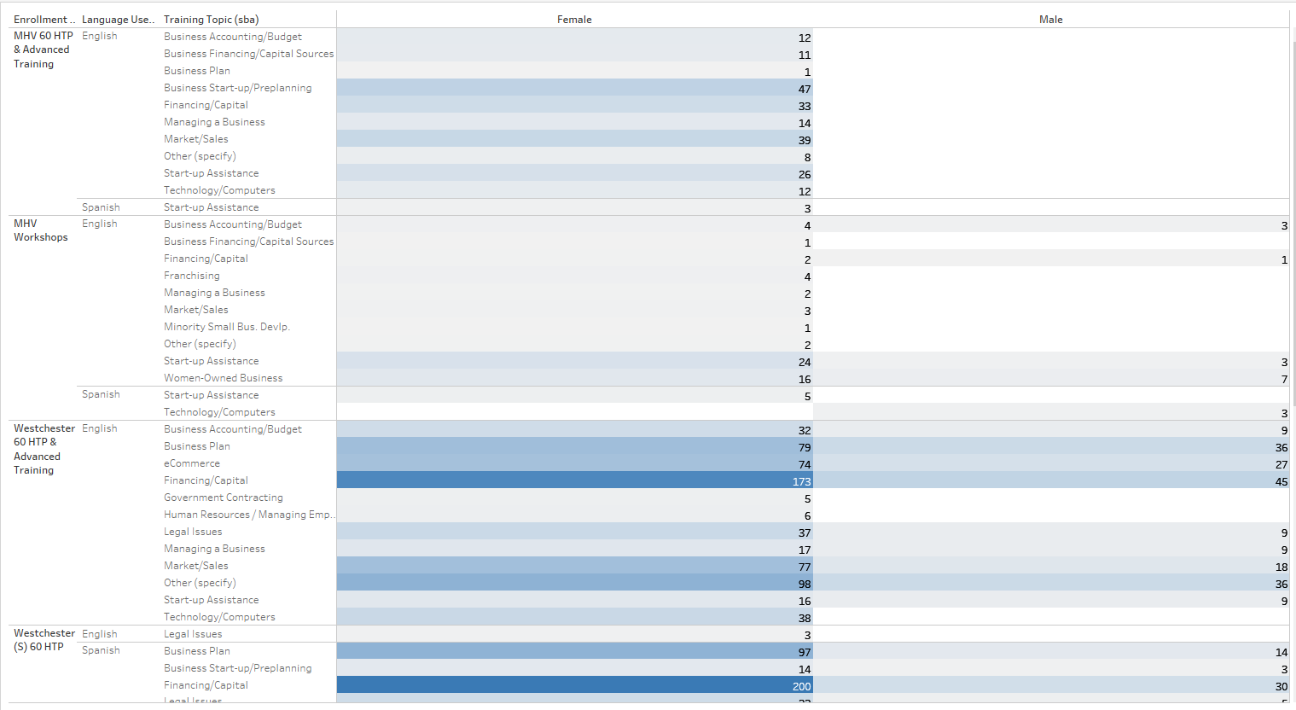
Screenshots of Data Visualizations

Slide 5
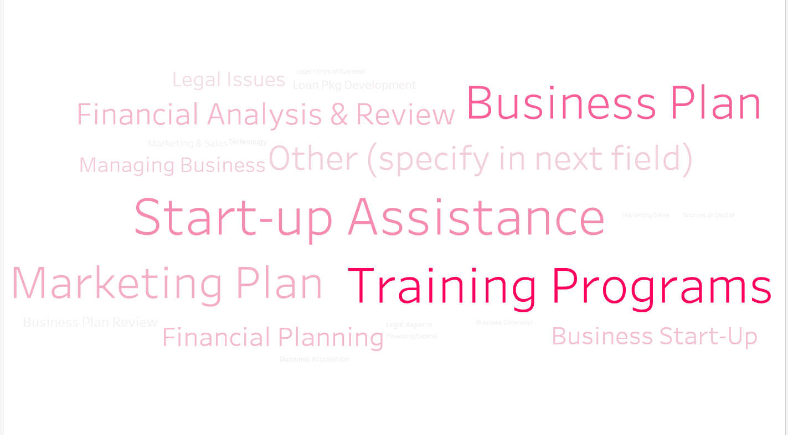
Screenshots of Data Visualizations

Slide 6
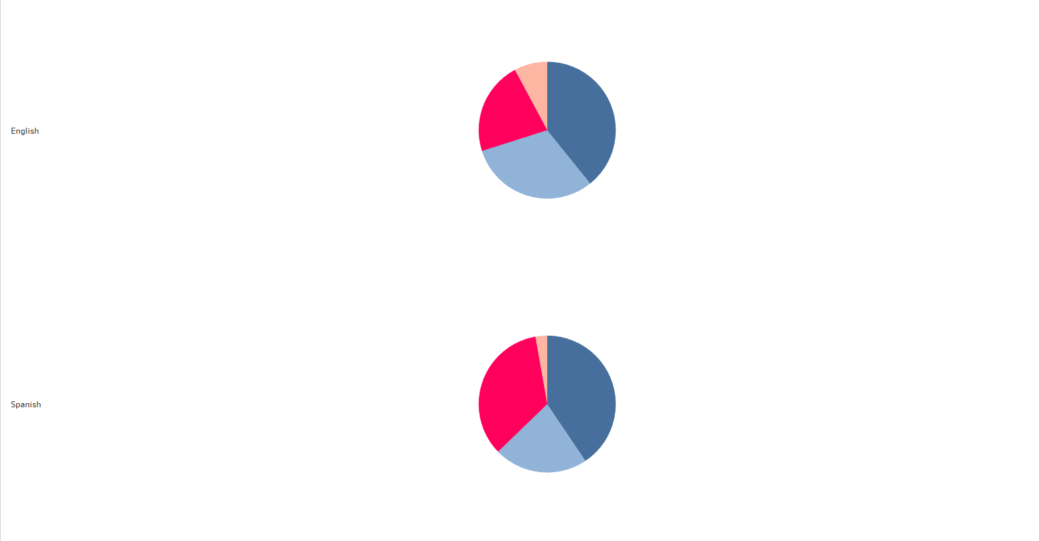
Screenshots of Data Visualizations

Slide 7
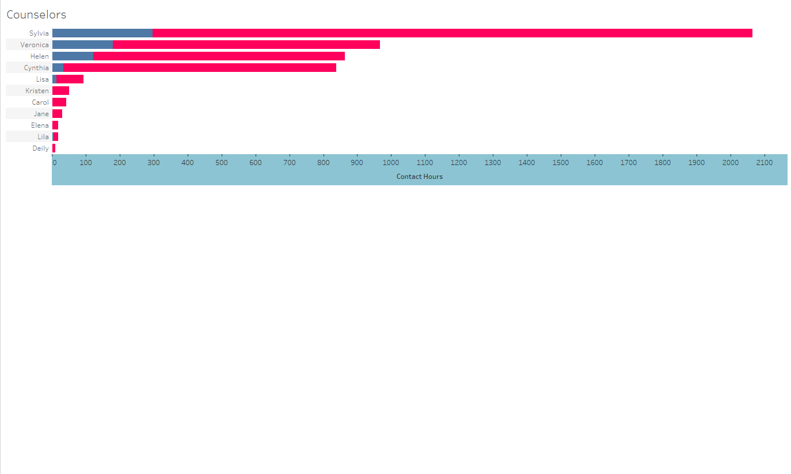
Screenshots of Data Visualizations

Slide 8
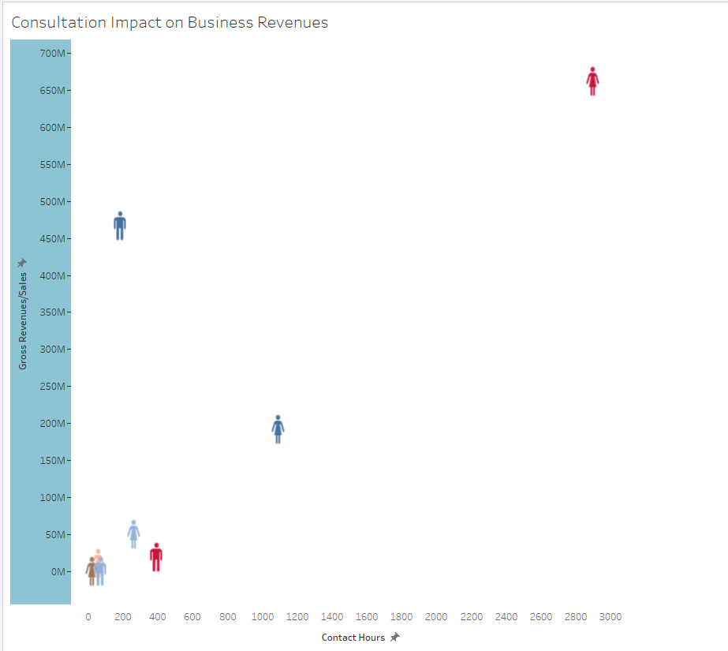
Screenshots of Data Visualizations

